Slide 1



JUNIOR SCHOOLS DEBATING CHAMPIONSHIPS 2026
Break Announcement
1
Notes:
DO IT WITH MORE SUSPENSE

Slide 2
A FEW NOTES BEFORE WE CONTINUE...
Equity - Research is not allowed
Breaking teams must be accompanied by their judge for the full day
--> reserve teams may be called upon
Observers
Trophies, medals, awards
Ties were not granted unless STD was exactly the same
Top Speakers have to had spoken for 3 or more rounds
O
2
Notes:
DO IT WITH MORE SUSPENSE

Slide 3
Best Speaker from Debut School
3

Slide 4

Ashwin Moorgani
SAIS
12

Slide 6
TOP 10 SPEAKERS
JSDC 2026
3

Slide 7
10TH BEST SPEAKER
Avg speaker score: 70.67
STDEV: 0.47
12

Slide 8
CHARLIZE WONG (HKIS MS)
13

Slide 9
9TH BEST SPEAKER
Avg speaker score: 70.78
STDEV: 0.31
14

Slide 10
THEODORE WANG (HKIS HS)
15

Slide 11
8TH BEST SPEAKER
Avg speaker score: 70.83
STDEV: 1.03
16

Slide 12
VERA HUI (GSIS)
17

Slide 13
7TH BEST SPEAKER
Avg speaker score: 70.83
STDEV: 0.47
18

Slide 14
RACHEL RHODES (GSIS)
19

Slide 15
6TH BEST SPEAKER
Avg speaker score:
71.00
STDEV: 0.71
20

Slide 16
CYRUS YUAN (DBS)
23

Slide 17
5TH BEST SPEAKER
Avg speaker score: 71.17
SD: 0.47
22

Slide 18
CATHY LI
(HYS)
25

Slide 19
4TH BEST SPEAKER
Avg Speaker score: 71.17
STDEV: 0.24
26

Slide 20
NORA CAPPELEN
(CDNIS)
27

Slide 21
3RD BEST SPEAKER
Avg Speaker score: 71.33
STDEV: 0.62
28

Slide 22
ALICE WAN
(HKIS HS)
29

Slide 23
2ND BEST SPEAKER
Avg speaker score: 71.33
STDEV: 0.47
30

Slide 24
Joanne Lau
(DGS)
31

Slide 25
BEST SPEAKER
Avg Speaker score: 71.50
STDEV: 0.71
32

Slide 26
EMI RUJIS
(CIS)
33

Slide 27
BREAKING TEAMS
JSDC 2026
34

Slide 28
BREAKING 8TH
3 wins
ATSS: 244.23
53

Slide 29
PLKCKY
54

Slide 30
BREAKING 7TH
3 wins
ATSS: 245.75
51

Slide 31
SISHK
52

Slide 32
BREAKING 6TH
3 wins
ATSS: 245.88
55

Slide 33
DGS
56

Slide 34
BREAKING 5TH
3 wins
ATSS: 246.19
57

Slide 35
HYS
58

Slide 36
BREAKING 4TH
3 wins
ATSS: 247.19
59

Slide 37
GSIS
60

Slide 38
BREAKING 3RD
3 wins
ATSS: 248.19
61

Slide 39
CIS
62

Slide 40
BREAKING 2ND
4 wins
ATSS: 245.75
65

Slide 41
DBS
66

Slide 42
BREAKING 1ST
4 wins
ATSS: 247.67
63

Slide 43
HKIS HS
64

Slide 44
RESERVE BREAKING 1ST
(9TH)
3 wins
ATSS: 243.92
67

Slide 45
SPCC
68

Slide 46
RESERVE BREAKING 2ND (10TH)
2 wins
ATSS: 244.94
69

Slide 47
CDNIS
70

Slide 48
DRAW FOR OCTOFINALS
71

Slide 49
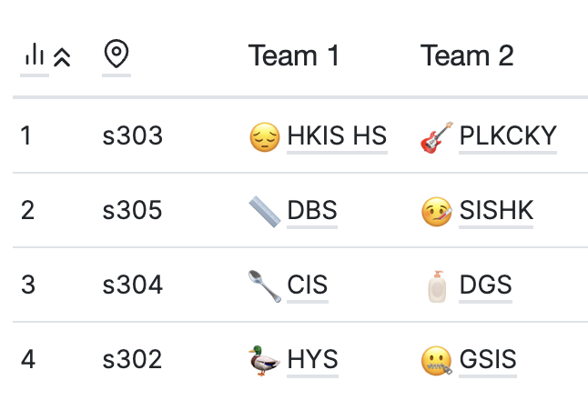
DRAW FOR OCTOFINALS
Proposition
Opposition
team
72

Slide 50
QUATERFINALS MOTION
This house regrets the glorification of start-up culture.
team
73

Slide 51
CONGRATULATIONS
to all teams and speakers!
74

Slide 52
ANNOUNCEMENT
We would like to invite the top 10 speakers to stay behind after results announcement to take a group photo.
75

