Slide 1


JUNIOR SCHOOLS DEBATING CHAMPIONSHIPS 2026 French International School (TKO)

Slide 2

Registration and Roll-Call

Slide 3
Welcome Message
Principal Helena

Slide 4
Quarter-Finals
(Prepared)

Slide 5
This house regrets the glorification of start-up culture

Slide 6
REMINDER
For all out-rounds, OA and comments will not be provided after the debate. Judges will be asked to announce the results to the teams back here in the main room after they have submitted their ballots.

Slide 7
SAFETY SLIDE

Slide 8
SAFETY SLIDE

Slide 9
SAFETY SLIDE

Slide 10
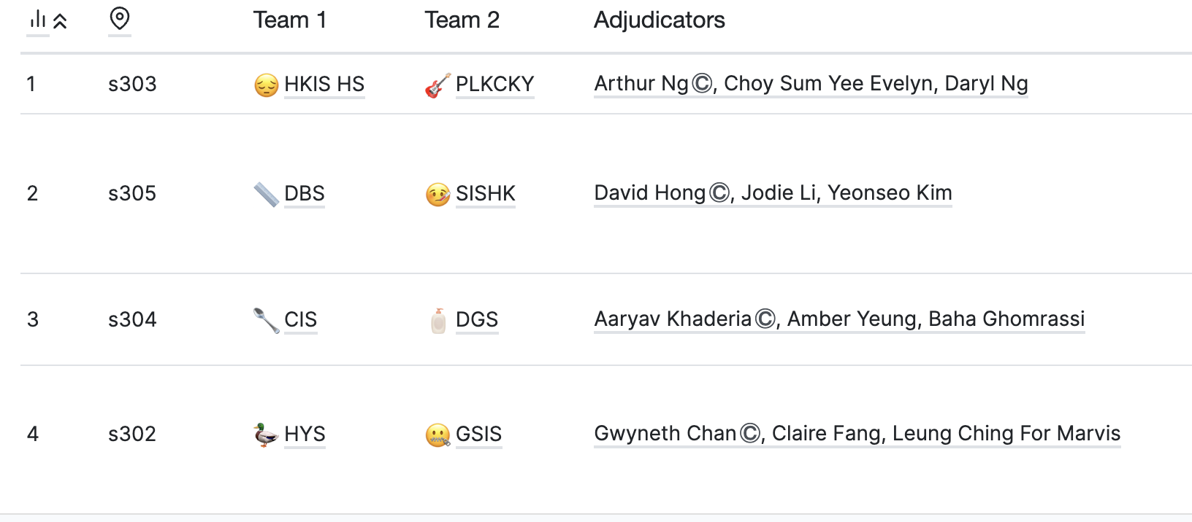
DRAW:

Slide 11
Semi Finals Results Announcement

Slide 12
Prep time - 11:20-12:05
Debate - 12:05-13:05

Slide 13
SAFETY SLIDE

Slide 14
SAFETY SLIDE

Slide 15
SAFETY SLIDE

Slide 16
SAFETY SLIDE

Slide 17
SAFETY SLIDE

Slide 18
SAFETY SLIDE

Slide 19
REMINDER
Online research/ use of AI is not permitted during the prep time of semi-prepared and impromptu debates/ during the debate. If any issues arise, please contact equity for clarifications. Thank you!

Slide 20
Theme: Philosophy

Slide 21
SAFETY SLIDE

Slide 22
SAFETY SLIDE

Slide 23
Infoslide:
Moral progression refers to the improvement and advancement of ethical standards, principles and behaviours within societies over time.

Slide 24
SAFETY SLIDE

Slide 25
SAFETY SLIDE

Slide 26
SAFETY SLIDE

Slide 27
Motion:
This house regrets the narrative that humanity is, and has always been, in a state of moral progression

Slide 28
Draw Release:

Slide 29
SAFETY SLIDE

Slide 30
SAFETY SLIDE

Slide 31
SAFETY SLIDE

Slide 32
SAFETY SLIDE

Slide 33
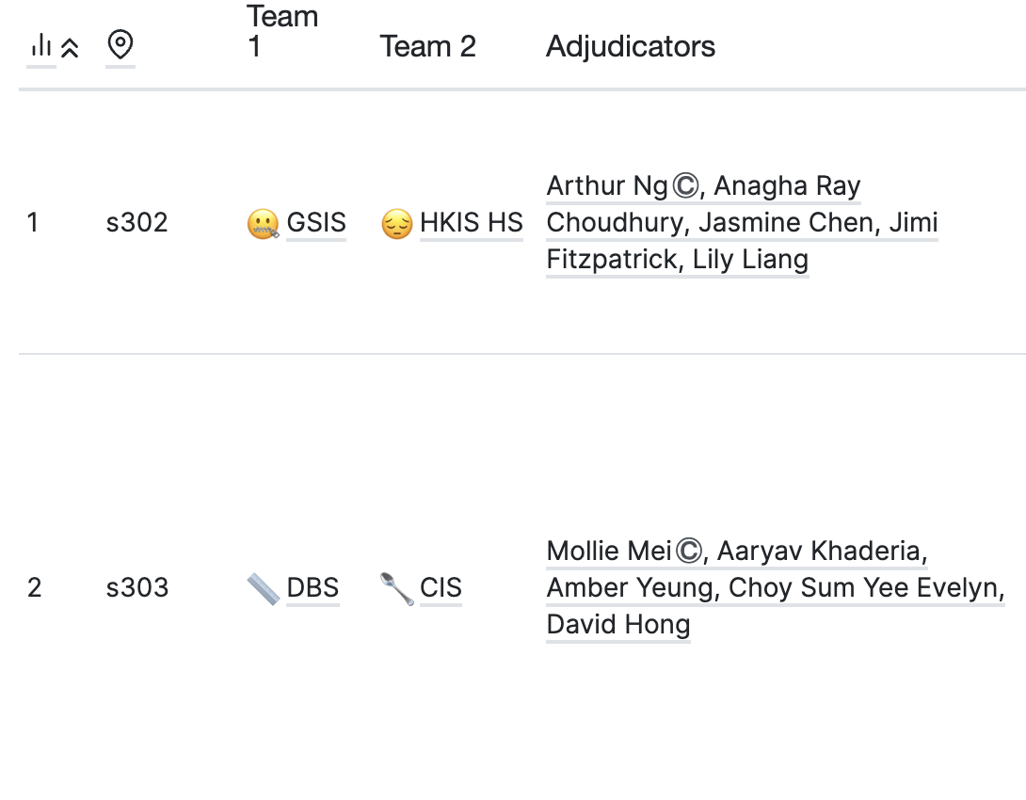
Draw:

Slide 34
Prep Time: 11:20 - 12:05

Slide 35
OA + Results Announcement

Slide 36
Grand Finals

Slide 37
SAFETY SLIDE

Slide 38
SAFETY SLIDE

Slide 39
SAFETY SLIDE

Slide 40
SAFETY SLIDE

Slide 41
SAFETY SLIDE

Slide 42
SAFETY SLIDE

Slide 43
SAFETY SLIDE

Slide 44
SAFETY SLIDE

Slide 45
SAFETY SLIDE

Slide 46
Prep time - 14:30 – 15:00
Debate time - 14:30 – 15:00

Slide 47
JSDC 2026 Grand Finals
DBS vs HKIS HS
motion:
This house, as a young adult living in Iran, prefers a world where the Iranian Revolution had not happened.

Slide 48
Infoslide: The 1979 Iranian Revolution overthrew Iran’s then-ruling western-installed Pahlavi Dynasty, replacing it with the Islamic Republic of Iran governed by the Ayatollahs.

Slide 49
draw for grand finals

Slide 50
GRAND FINAL ANNOUNCEMENTS

Slide 51
OA + COMMENTS

Slide 52
JSDC 2026
GRAND CHAMPION

Slide 53
SAFETY SLIDE

Slide 54
SAFETY SLIDE

Slide 55
SAFETY SLIDE

Slide 56
SAFETY SLIDE

Slide 57
SAFETY SLIDE

Slide 58
SAFETY SLIDE

Slide 59
SAFETY SLIDE

Slide 60
SAFETY SLIDE

Slide 61
SAFETY SLIDE

Slide 62
SAFETY SLIDE

Slide 63
DBS

Slide 64
JSDC 2026
GRAND FINALS
BEST SPEAKER

Slide 65
SAFETY SLIDE

Slide 66
SAFETY SLIDE

Slide 67
SAFETY SLIDE

Slide 68
SAFETY SLIDE

Slide 69
SAFETY SLIDE

Slide 70
SAFETY SLIDE

Slide 71
SAFETY SLIDE

Slide 72
SAFETY SLIDE

Slide 73
SAFETY SLIDE

Slide 74
PIERS KO
(HKIS HS)

Slide 75
HKIS
1st Runner Up

Slide 76
CIS
Semi Finalist

Slide 77
GSIS
Semi Finalist

Slide 78
thank you and congratulations to all teams and speakers!

